Slide 1


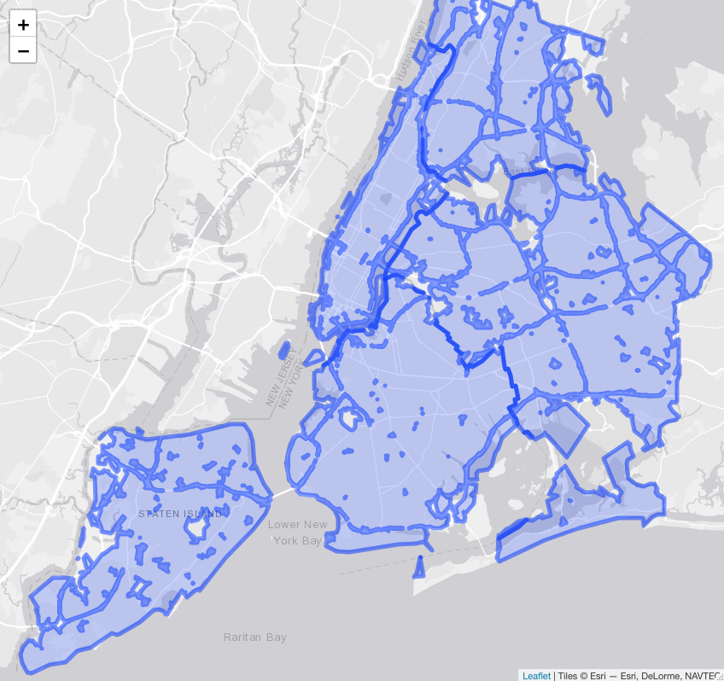
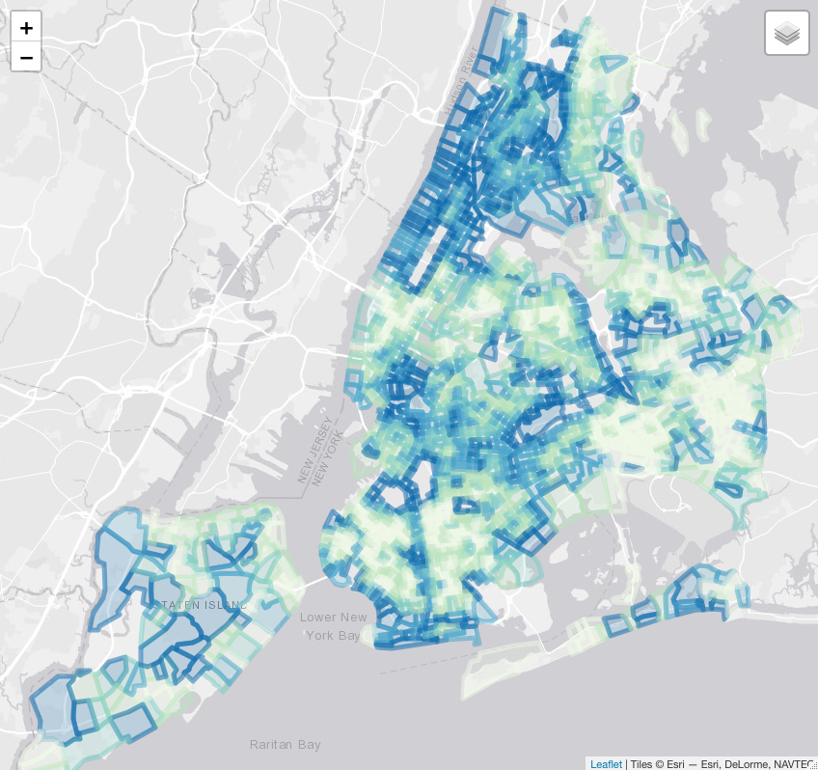
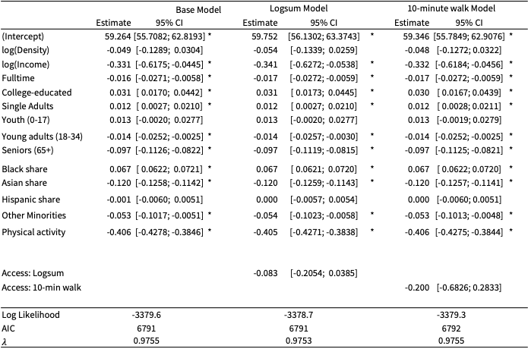
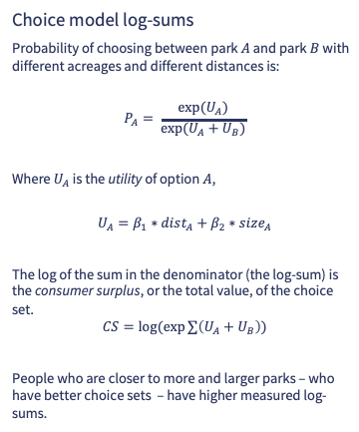
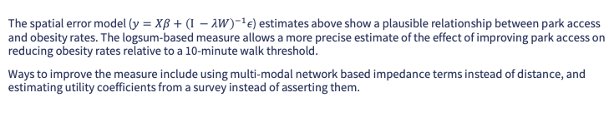
Choice theory can help measure health consequences of park access.
Highlights
In places with many parks, most people will have 10-minute walk access. But this does not mean all access is the same.
If we can establish how far people are willing to travel to access different park amenities, then we can create a continuous accessibility measure.
The continuous measure may be more helpful in estimating park benefits at a neighborhood level.
In this case, better access is correlated with more physical activity participation and lower obesity rates.
Choice model log-sums
Probability of choosing between park $A$ and park $B$ with different acreages and different distances is:
$$P_{A}= \frac{exp⁡(U_{A})}{exp⁡(U_{A}+U_{B})}$$
Where $U_{A}$ is the utility of option $A$,
$$U_{A}=β_{1}∗dist_{A}+β_{2}∗size_{A}$$
The log of the sum in the denominator (the log-sum) is the consumer surplus, or the total value, of the choice set.
$$CS=log⁡(exp∑\left(U_{A}+U_{B}\right))$$
People who are closer to more and larger parks – who have better choice sets – have higher measured log-sums.
Greg Macfarlane¹, Nico Boyd², John E. Taylor³, Kari Watkins³
¹ Brigham Young University, Provo Utah
² Fehr and Peers, Los Angeles California
³ Georgia Institute of Technology, Atlanta Georgia
Park access is correlated with neighborhood-level obesity
Correspondence: gregmacfarlane@byu.edu
 | Base Model | Base Model |  |  | Logsum Model |  |  | 10-minute walk Model
 | Estimate | Estimate | 95% CI |  | Estimate | 95% CI |  | Estimate | 95% CI
(Intercept) | 59.264 | 59.264 | [55.7082; 62.8193] | * | 59.752 | [56.1302; 63.3743] | * | 59.346 | [55.7849; 62.9076] | *
log(Density) | -0.049 | -0.049 | [-0.1289; 0.0304] |  | -0.054 | [-0.1339; 0.0259] |  | -0.048 | [-0.1272; 0.0322]
log(Income) | -0.331 | -0.331 | [-0.6175; -0.0445] | * | -0.341 | [-0.6272; -0.0538] | * | -0.332 | [-0.6184; -0.0456] | *
Fulltime | -0.016 | -0.016 | [-0.0271; -0.0058] | * | -0.017 | [-0.0272; -0.0059] | * | -0.017 | [-0.0272; -0.0059] | *
College-educated | 0.031 | 0.031 | [ 0.0170; 0.0442] | * | 0.031 | [ 0.0173; 0.0445] | * | 0.030 | [ 0.0167; 0.0439] | *
Single Adults | 0.012 | 0.012 | [ 0.0027; 0.0210] | * | 0.012 | [ 0.0027; 0.0210] | * | 0.012 | [ 0.0028; 0.0211] | *
Youth (0-17) | 0.013 | 0.013 | [-0.0020; 0.0277] |  | 0.013 | [-0.0020; 0.0277] |  | 0.013 | [-0.0019; 0.0279]
Young adults (18-34) | -0.014 | -0.014 | [-0.0252; -0.0025] | * | -0.014 | [-0.0257; -0.0030] | * | -0.014 | [-0.0252; -0.0025] | *
Seniors (65+) | -0.097 | -0.097 | [-0.1126; -0.0822] | * | -0.097 | [-0.1119; -0.0815] | * | -0.097 | [-0.1125; -0.0821] | *
Black share | 0.067 | 0.067 | [ 0.0622; 0.0721] | * | 0.067 | [ 0.0621; 0.0720] | * | 0.067 | [ 0.0622; 0.0720] | *
Asian share | -0.120 | -0.120 | [-0.1258; -0.1142] | * | -0.120 | [-0.1259; -0.1143] | * | -0.120 | [-0.1257; -0.1141] | *
Hispanic share | -0.001 | -0.001 | [-0.0060; 0.0051] |  | 0.000 | [-0.0057; 0.0054] |  | 0.000 | [-0.0060; 0.0051]
Other Minorities | -0.053 | -0.053 | [-0.1017; -0.0051] | * | -0.054 | [-0.1023; -0.0058] | * | -0.053 | [-0.1013; -0.0048] | *
Physical activity | -0.406 | -0.406 | [-0.4278; -0.3846] | * | -0.405 | [-0.4271; -0.3838] | * | -0.406 | [-0.4275; -0.3844] | *
Access: Logsum |  |  |  |  | -0.083 | [-0.2054; 0.0385]
Access: 10-min walk |  |  |  |  |  |  |  | -0.200 | [-0.6826; 0.2833]
Log Likelihood | -3379.6 |  |  |  | -3378.7 |  |  | -3379.3
AIC | 6791 |  |  |  | 6791 |  |  | 6792
$λ$ | 0.9755 |  |  |  | 0.9753 |  |  | 0.9755
The Trust for Public Lands develops a “Park Score” for a city based on the percent of people who live within a 10-minute walk of a public park, the total public park acreage, and a number of other factors. This allows for cities to be easily compared against each other, but in a place like New York almost the entire city is within the threshold.
By weighting a neighborhood (census tract) based on the acreage of nearby parks and the travel costs, we can show that some neighborhoods have more options, and therefore more access, than others. This access is correlated with public health outcomes at the neighborhood level.
The spatial error model ($y=Xβ+{\left(I −λW\right)}^{−1}ε$) estimates above show a plausible relationship between park access and obesity rates. The logsum-based measure allows a more precise estimate of the effect of improving park access on reducing obesity rates relative to a 10-minute walk threshold.
Ways to improve the measure include using multi-modal network based impedance terms instead of distance, and estimating utility coefficients from a survey instead of asserting them.
Notes:
Notes:
In Powerpoint, click View > Guides
Keep text within gutter guides.
Author list: Don’t split names onto two lines (e.g., “Jimmy [break] Smith”). If that happens, use a new line, unless you need the space. Bold the first names of anybody who’s presenting in person.
Intro/methods/result: Do not drop below font size 28, but if you have extra space, jack up the font size until the space is full.
Do not use color in the sidebars except in graphs/figures. It’ll pull attention from the center and slow interpretation for passersby.

